Slide 1
CSC 323 – Principles of Operating Systems
Instructor: Ms. Mamoona Tasadduq
Lecture# 03(b): Inter-Process Communication

Slide 2
Inter-process Communication
Processes within a system may be independent or cooperating.
Cooperating process can affect or be affected by other processes, including sharing data
Reasons for cooperating processes:
  Information sharing
  Computation speedup
  Modularity
  Convenience
Cooperating processes need inter-process communication (IPC)

Slide 3
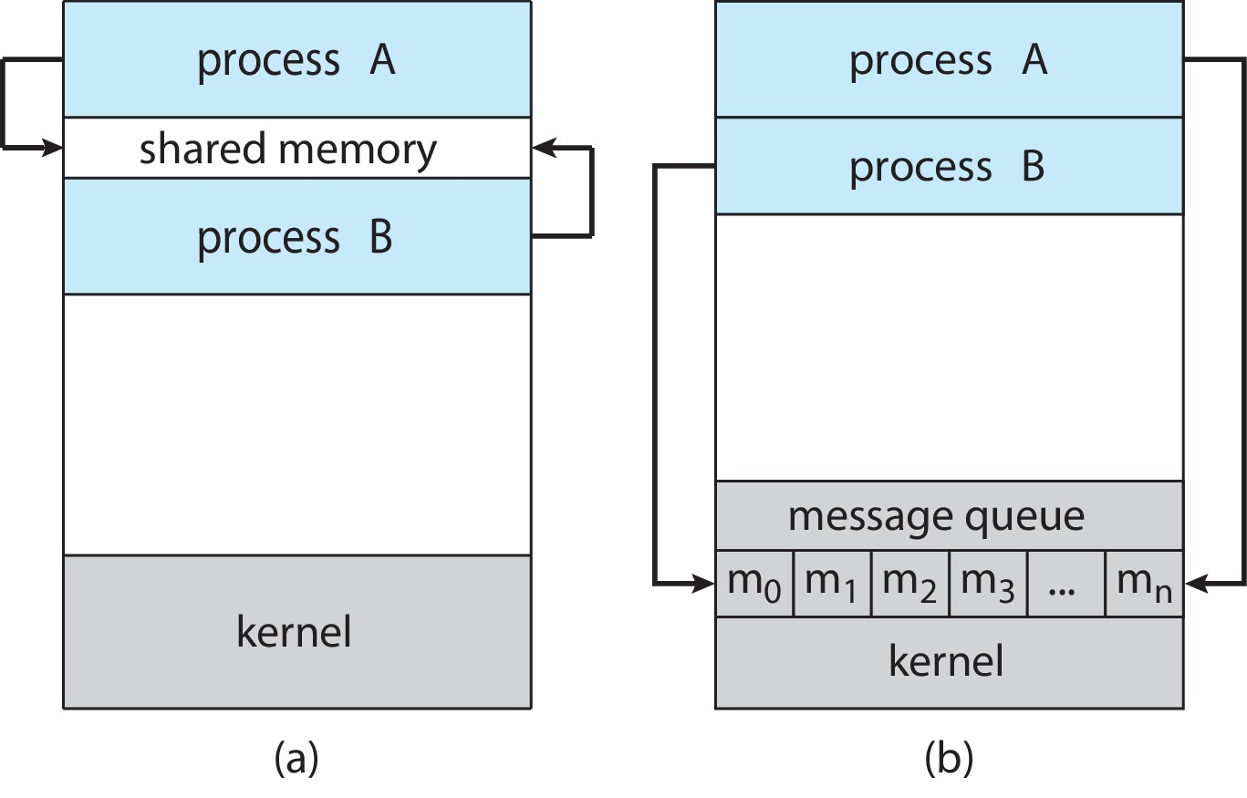
Inter-process Communication
Two models of IPC.
  Shared memory
  Message passing
(a) Shared memory. b) Message passing.

Slide 4
IPC – Shared Memory Model
An area of memory shared among the processes that wish to communicate
The communication is under the control of the users’ process and not the OS.
Used for large amount of data transfer.
Major issue is to provide mechanism that allows the user processes to synchronize their actions when they access shared memory.
Mostly used in shared memory systems.

Slide 5
IPC – Message Passing Model
Processes communicate with each other without resorting to shared variables
IPC facility provides two operations:
  send(message) – message size fixed or variable
  receive(message)
If two processes wish to communicate, they need to:
  Establish a communication link between them
  Exchange messages via send/receive
Implementation of communication link:
  physical (e.g., shared memory, hardware bus, network)
  logical (e.g., direct/indirect, synchronous/asynchronous, automatic/explicit buffering)
Mostly used in distributed systems, for small amount of data transfer (fixed or variable length messages) as it is time consuming.

Slide 6
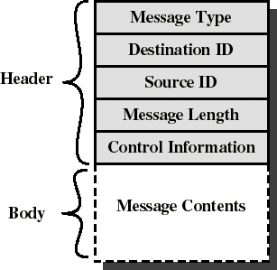
Message Format
Consists of header and body of the message.
In UNIX: no ID, only message type
Control Information
  What to do if run out of buffer space
  Sequence numbers
  Priority
Queuing discipline: usually FIFO but can also include priorities

Slide 7
Implementation Questions
How are links established?
Can a link be associated with more than two processes?
How many links can there be between every pair of communicating processes?
What is the capacity of a link?
Is the size of a message that the link can accommodate fixed or variable?
Is a link unidirectional or bi-directional?

Slide 8
Direct Communication
Processes must name each other explicitly:
  send (P, message) – send a message to process P
  receive(Q, message) – receive a message from process Q
Properties of direct communication link:
  Links are established automatically
  A link is associated with exactly one pair of communicating processes
  Between each pair, there exists exactly one link
  The link may be unidirectional, but is usually bi-directional

Slide 9
Indirect Communication
Messages are directed and received from mailboxes (also referred to as ports)
  Each mailbox has a unique id
  Processes can communicate only if they share a mailbox
Properties of indirect communication link:
  Link established only if processes share a common mailbox
  A link may be associated with many processes
  Each pair of processes may share several communication links
  Link may be unidirectional or bi-directional
Operations:
  create a new mailbox
  send and receive messages through mailbox
  destroy a mailbox

Slide 10
Indirect Communication
Primitives are defined as:
  send (A, message) – send a message to mailbox A
  receive(A, message) – receive a message from mailbox A
Mailbox sharing – consider the following …
  P1, P2, and P3 share mailbox A
  P1, sends; P2 and P3 receive
  Who gets the message?
Possible Solutions to avoid unpredictable behavior
  Allow a link to be associated with at most two processes
  Allow only one process at a time to execute a receive operation
  Allow system to select an arbitrarily receiver. Sender is notified who the receiver was.

Slide 11
Synchronization
Message passing may be either blocking or non-blocking.
Blocking is considered synchronous.
  Blocking send – the sender is blocked until the message is received
  Blocking receive – the receiver is blocked until a message is available
Non-blocking is considered asynchronous.
  Non-blocking send – the sender sends the message and continues
  Non-blocking receive – the receiver receives a valid message or null message
message next_produced;
while (true) {
/* produce an item */
send(next_produced);
}
message next_consumed;
while (true) {
receive(next_consumed);
/* consume the item */
}

Slide 12
Link Capacity – Buffering
Regardless of how messages are exchanged between processes, queue of messages attached to the link.
Queuing can be implemented in one of three ways
  Zero capacity – no messages are queued on a link.
    Sender must wait (or block) until the receiver gets the message
  Bounded capacity – queue has finite length of n messages
    Sender must wait if link full
  Unbounded capacity – queue has “infinite” length
    Sender never waits

Slide 13
Examples of IPC Systems – POSIX
POSIX Shared Memory
  Process first creates shared memory segment
shm_fd = shm_open(name, O CREAT | O RDWR, 0666);
Also used to open an existing segment
Set the size of the object
ftruncate(shm_fd, 4096);
Use mmap() to memory-map a file pointer to the shared memory object
Reading and writing to shared memory is done by using the pointer returned by mmap().

Slide 14
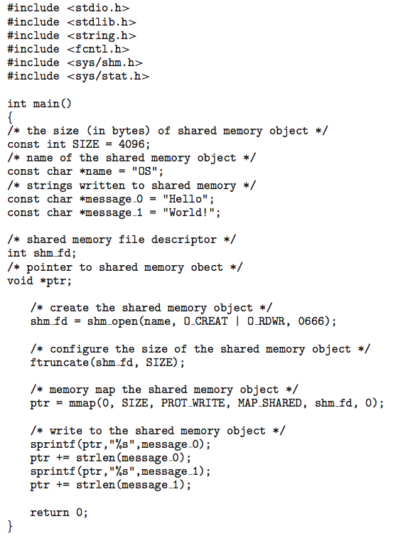
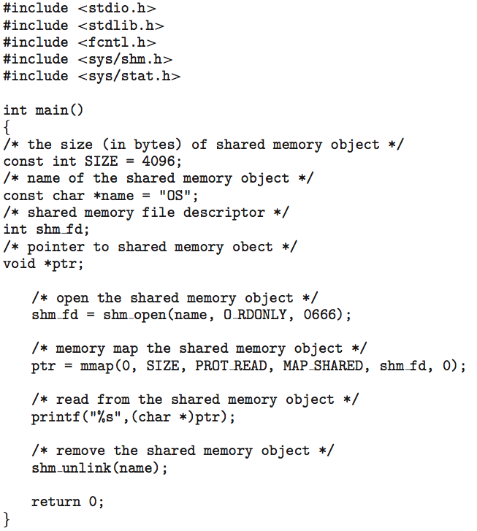
IPC POSIX Producer and Consumer

Slide 15
Pipes
Acts as a channel allowing two processes to communicate.
Some issues:
  Is communication unidirectional or bidirectional?
  In the case of two-way communication, is it half or full-duplex?
  Must there exist a relationship (i.e., parent-child) between the communicating processes?
  Can the pipes be used over a network?
Ordinary (unnamed) pipes – cannot be accessed from outside the process that created it. Typically, a parent process creates a pipe and uses it to communicate with a child process that it created.
Named pipes – can be accessed without a parent-child relationship.

Slide 16
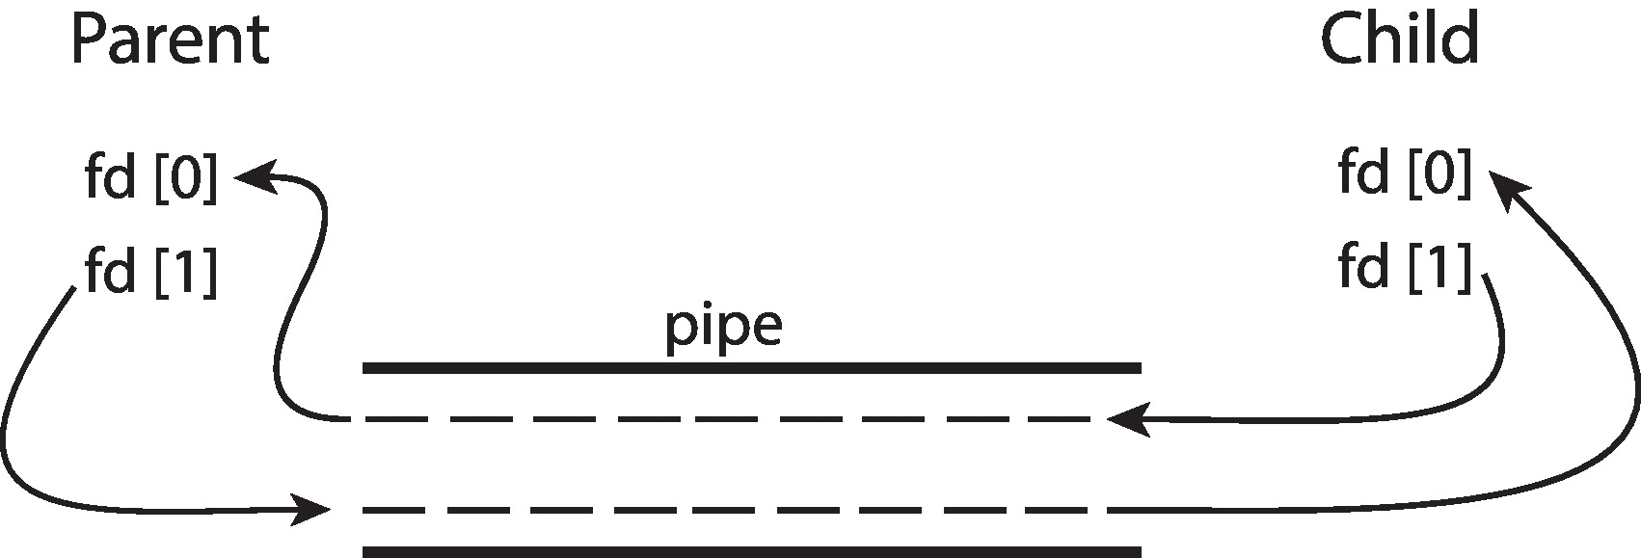
Ordinary Pipes
Ordinary Pipes allow communication in standard producer-consumer style
Producer writes to one end (the write-end of the pipe)
Consumer reads from the other end (the read-end of the pipe)
Ordinary pipes are therefore unidirectional
Require a parent-child relationship between communicating processes
Windows calls it anonymous pipes

Slide 17
Named Pipes
Named Pipes are more powerful than ordinary pipes
Communication is bidirectional
No parent-child relationship is necessary between the communicating processes
Several processes can use the named pipe for communication
Provided on both UNIX and Windows systems

Slide 18
Communication in Client-Server Systems
Various mechanisms for communication between client-server systems
  Sockets
  Remote Procedure Calls (RPCs)

Slide 19
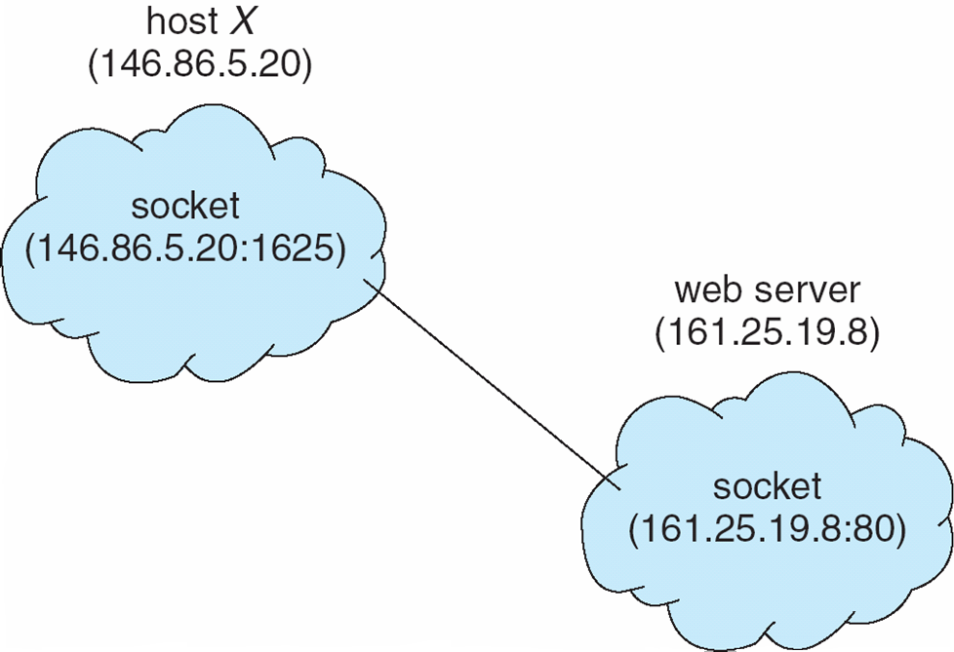
Sockets
A socket is defined as an endpoint for communication.
Concatenation of IP address and port.
The socket 161.25.19.8:1625 refers to port 1625 on host 161.25.19.8
Communication consists between a pair of sockets
All ports below 1024 are well known, used for standard services
Special IP address 127.0.0.1 (loopback) to refer to system on which process is running

Slide 20
Remote Procedure Calls (RPCs)
RPC abstracts procedure calls between processes on a networked system.
  Uses ports for service differentiation
Stubs – client-side proxy for the actual procedure on the server.
The client-side stub locates the server and marshals the parameters.
The server-side stub receives this message, unpacks the marshalled parameters, and performs the procedure on the server.
Stubs can be generated automatically using tools like IDL (Interface Definition Language) compilers.

Slide 21
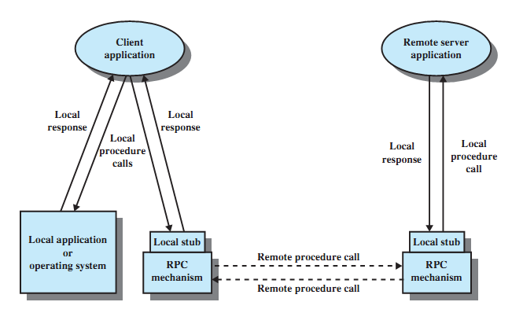
Remote Procedure Call Mechanism

Slide 22
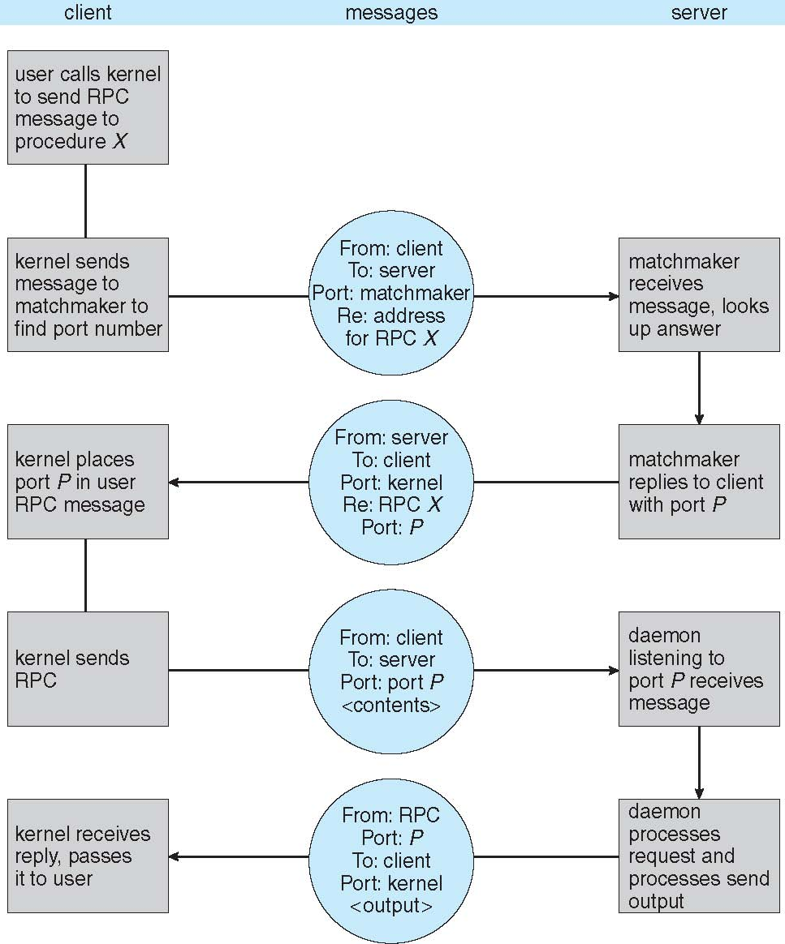
Execution of Remote Procedure Call

